Slide 1
Exploring GCP Dataproc Cluster: Simplifying Big Data Processing
Leveraging Cloud Solutions for Efficient Data Management
Notes:
--- In this presentation, we will delve into Google Cloud Platform's Dataproc service. Dataproc offers a powerful solution for processing large datasets efficiently. We will cover its features, how to set up clusters, manage them, run jobs, and optimize costs.

Slide 2
Agenda Overview
Introduction to GCP Dataproc
Setting Up a Dataproc Cluster
Managing and Scaling Dataproc Clusters
Running Jobs on Dataproc Clusters
Cost Optimization and Best Practices
Notes:
This presentation includes an introduction to GCP Dataproc and its core features, followed by steps for setting up and managing Dataproc clusters. We will also look at job execution on these clusters and conclude with cost optimization strategies and best practices.

Slide 3
Introduction to GCP Dataproc
Notes:
GCP Dataproc is a fully managed cloud service that simplifies the process of running big data processing frameworks such as Apache Spark and Hadoop. It allows for rapid provisioning of clusters and efficient data processing.

Slide 4

What Is GCP Dataproc?
Scalable Big Data Service
GCP Dataproc is designed to handle scalable big data workloads efficiently in the cloud environment.
Seamless Integration
It integrates smoothly with other Google Cloud services, enhancing the functionality and ease of use for users.
Quick Setup and Management
GCP Dataproc allows for quick setups and easy management of processing clusters, streamlining big data operations.
Notes:
GCP Dataproc is a scalable, easy-to-use service that enables users to run big data workloads in the cloud. It integrates seamlessly with other Google Cloud services and allows for quick setup and management of processing clusters.

Slide 5

Core Features and Benefits
Fast Cluster Creation
Dataproc allows for rapid deployment of clusters, enabling quick access to computing resources for data processing tasks.
Flexible Scaling Options
Users can easily scale their resources up or down based on their needs, ensuring efficient resource utilization.
Support for Open-Source Tools
Dataproc integrates seamlessly with a variety of open-source tools, enhancing its functionality for data analysis projects.
Focus on Data Analysis
By abstracting infrastructure management, Dataproc allows users to concentrate on deriving insights from their data.
Notes:
Dataproc provides numerous benefits including fast cluster creation, flexible scaling options, and support for open-source tools. It allows users to focus on data analysis without worrying about infrastructure management.

Slide 6

Use Cases and Applications
Data Processing
Dataproc excels in efficiently handling massive datasets for data processing tasks, ensuring quick insights and results.
Machine Learning
Organizations leverage Dataproc for machine learning applications to build and train models effectively and at scale.
Data Analytics
Dataproc supports advanced data analytics, enabling organizations to derive actionable insights from their data in real-time.
Notes:
Dataproc is ideal for a variety of use cases, including data processing, machine learning, and data analytics. Organizations use it for batch processing, ETL jobs, and real-time analytics.

Slide 7
Setting Up a Dataproc Cluster
Notes:
Setting up a Dataproc cluster is straightforward, allowing users to get started with big data processing quickly. We will explore the prerequisites and initial setup needed to create a cluster.

Slide 8

Pre-Requisites and Initial Setup
Google Cloud Account
You must have a Google Cloud account to create a Dataproc cluster and access its features.
Billing Enabled
Ensure that billing is enabled on your Google Cloud account to utilize Dataproc services without interruptions.
IAM Permissions
The necessary IAM permissions must be configured to allow access to Dataproc resources securely.
Google Cloud SDK
Install the Google Cloud SDK to perform command-line operations related to Dataproc cluster management.
Notes:
Before creating a Dataproc cluster, you need to have a Google Cloud account, billing enabled, and the necessary IAM permissions. Ensure that you have the Google Cloud SDK installed for command-line operations.

Slide 9

Creating a Cluster Using GCP Console
Cluster Configuration
Users can select important configurations like cluster name, region, and machine types while creating a cluster.
User-Friendly Process
The GCP Console provides a guided and user-friendly experience for creating Dataproc clusters, making it accessible to all users.
Notes:
Creating a Dataproc cluster through the GCP Console involves selecting the desired configurations such as the cluster name, region, and machine types. This process is user-friendly and guided.

Slide 10
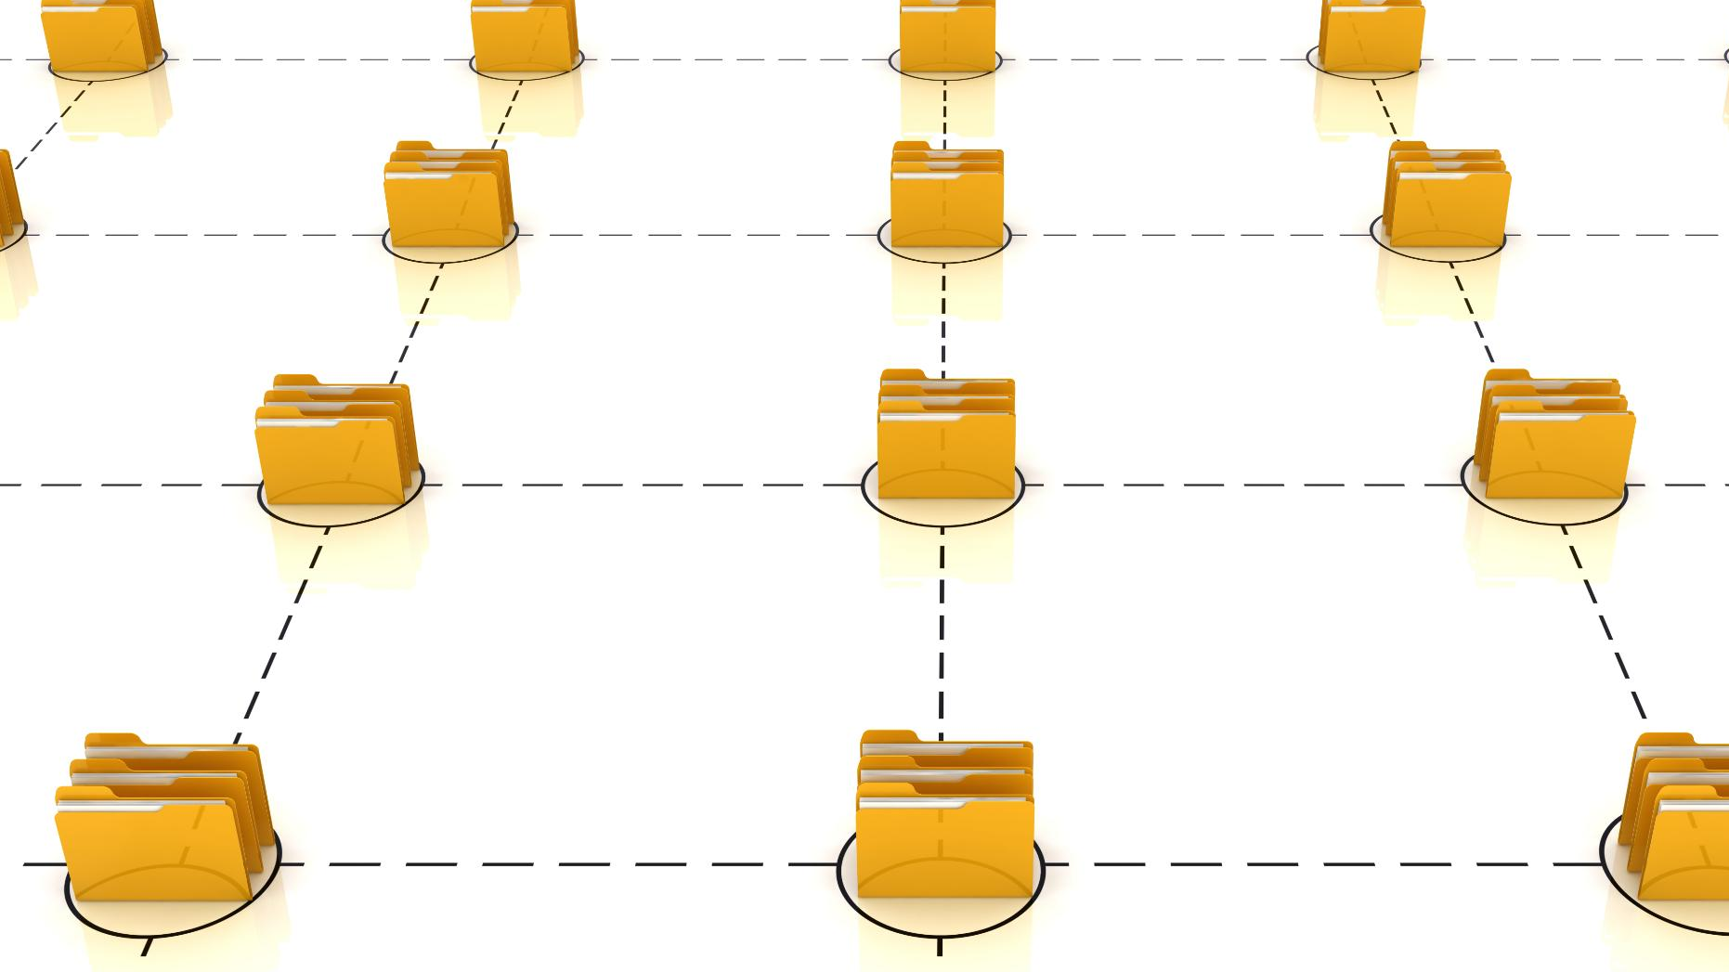
Configuration Options and Customization
Cluster Configuration
Dataproc provides options for customizing cluster configurations to meet various user requirements and preferences.
Software Components
Users can select specific software components to optimize their cluster's performance in line with their workflow needs.
Network and Storage Settings
Customization options extend to network settings and storage configurations to enhance data accessibility and processing speed.
Notes:
Dataproc allows for customization of cluster configurations including the choice of software components, network settings, and storage options. Users can tailor the cluster to fit their specific needs.

Slide 11
Managing and Scaling Dataproc Clusters
Notes:
Once clusters are set up, effective management and scaling are crucial. This section will cover monitoring performance and adjusting cluster sizes based on workload.

Slide 12

Monitoring Cluster Performance
Tools for Monitoring
GCP offers a variety of tools that enable users to effectively monitor their Dataproc clusters, ensuring optimal performance.
Key Performance Metrics
Monitoring key metrics such as CPU usage, memory consumption, and job execution times helps maintain cluster performance.
Optimal Performance Maintenance
Regular monitoring and analysis of performance data are crucial for maintaining the efficiency and reliability of Dataproc clusters.
Notes:
GCP provides tools for monitoring Dataproc clusters, allowing users to track metrics such as CPU usage, memory consumption, and job execution times. This information is essential for maintaining optimal performance.

Slide 13

Scaling Clusters up or Down
Dynamic Scaling Features
Dataproc's dynamic scaling allows users to adjust cluster resources based on real-time needs, optimizing resource utilization.
Cost Management
By adjusting resources dynamically, users can manage costs effectively without compromising on performance or availability.
Performance Optimization
Scaling resources effectively ensures that performance remains optimal, even during peak usage times.
Notes:
Dataproc supports dynamic scaling, enabling users to increase or decrease cluster resources based on current demands. This flexibility helps in cost management while ensuring performance.

Slide 14

Automating Cluster Management with Workflows
Cluster Management Automation
Automating cluster management enhances efficiency by reducing manual intervention and streamlining operations.
GCP Workflow Tools
GCP offers robust tools to create and execute workflows that facilitate big data processing tasks efficiently.
Improving Efficiency
Using workflows to automate jobs leads to improved efficiency and faster processing times for big data tasks.
Notes:
Workflows can automate the management of clusters and jobs. GCP provides tools to create and execute workflows that streamline big data processing tasks, improving efficiency.

Slide 15
Running Jobs on Dataproc Clusters
Notes:
After setting up and managing clusters, running jobs becomes the next focus. This section discusses how to submit jobs and integrate with big data frameworks.

Slide 16

Submitting Jobs Using GCP Console
GCP Console Overview
The GCP Console provides a user-friendly interface for managing and submitting jobs in the cloud.
Specifying Job Parameters
Users can specify job parameters directly in the GCP Console, ensuring the jobs run with the desired configurations.
Input and Output Data Management
The GCP Console allows users to define input data sources and output locations for efficient job execution.
Notes:
Jobs can be submitted directly from the GCP Console, where users can specify job parameters, input data, and output locations. This straightforward method simplifies the job execution process.

Slide 17
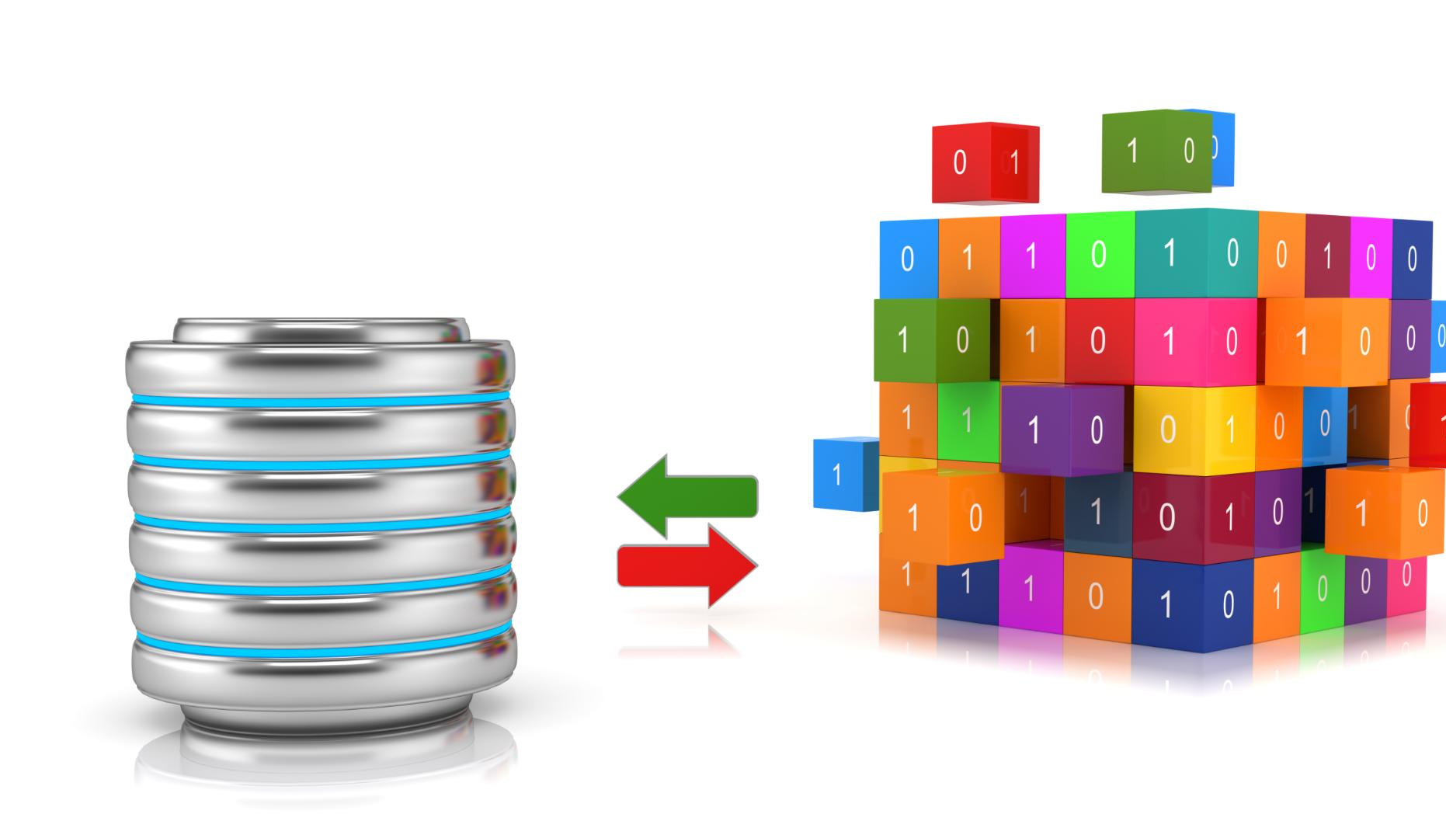
Integrating with Apache Spark and Hadoop
Seamless Integration
Dataproc offers a seamless integration with Apache Spark and Hadoop, simplifying big data processing.
Powerful Processing Capabilities
The integration enables users to leverage powerful processing capabilities for big data analytics efficiently.
Enhanced Performance
This integration enhances system performance, allowing for quicker and more efficient analytics.
Notes:
Dataproc allows seamless integration with Apache Spark and Hadoop, enabling users to leverage powerful big data processing capabilities. This integration enhances performance and supports complex analytics.

Slide 18

Analyzing Job Results and Logs
Importance of Analysis
Analyzing job results and logs is crucial for gaining insights into job performance and identifying improvements.
GCP Tools
Google Cloud Platform provides tools to conveniently view logs and metrics for effective analysis and troubleshooting.
Optimization Opportunities
Through analysis, teams can find optimization opportunities that enhance job outcomes and overall efficiency.
Notes:
After job completion, analyzing results and logs is essential for understanding job performance and outcomes. GCP provides tools to view logs and metrics, facilitating troubleshooting and optimization.

Slide 19
Cost Optimization and Best Practices
Notes:
Understanding cost implications and implementing best practices is vital for maximizing efficiency and minimizing expenses in GCP Dataproc usage. This section focuses on strategies for cost control.

Slide 20

Estimating and Controlling Costs
Pricing Calculators
GCP offers pricing calculators that allow users to estimate their Dataproc usage costs effectively and accurately.
Budgeting Tools
Budgeting tools provided by GCP assist users in managing their expenses related to Dataproc services, ensuring cost control.
Monitoring Usage Patterns
Monitoring usage patterns is essential for maintaining budget adherence and optimizing resource utilization in cloud services.
Notes:
GCP provides pricing calculators and budgeting tools to help users estimate and manage their Dataproc usage costs. Monitoring usage patterns is critical for budget adherence.

Slide 21

Best Practices for Resource Utilization
Optimizing Job Configurations
Optimizing job configurations helps in maximizing the efficiency of resource use, leading to reduced costs and improved performance.
Choosing Appropriate Machine Types
Selecting the right machine types for specific tasks ensures effective resource utilization and enhances overall system performance.
Scheduling Jobs During Off-Peak Hours
Scheduling jobs during off-peak hours can lead to better resource availability and lower operational costs.
Notes:
Implementing best practices such as optimizing job configurations, choosing appropriate machine types, and scheduling jobs during off-peak hours can significantly enhance resource utilization.

Slide 22
Security and Compliance Considerations
Importance of Security
Ensuring security is vital when handling big data, as it protects sensitive information from unauthorized access.
Data Encryption
GCP Dataproc provides data encryption features to safeguard sensitive data from breaches and unauthorized access.
Identity Management
Effective identity management is crucial for controlling access to sensitive data, ensuring only authorized users have access.
Notes:
Ensuring security and compliance is essential when working with big data. GCP Dataproc provides features for data encryption, identity management, and access control to protect sensitive information.

Slide 23
Conclusion
Managed Big Data Processing
GCP Dataproc offers a managed solution for big data processing, reducing complexity and maintenance overhead.
Scalable Platform
Its scalable nature allows users to handle varying workloads efficiently, adapting to the needs of different data processing tasks.
Optimizing Workflows
By implementing best practices, users can optimize their data processing workflows for improved performance and efficiency.
Notes:
GCP Dataproc simplifies big data processing by providing a managed, scalable platform for running Apache Spark and Hadoop jobs. By understanding its features and best practices, users can optimize their data processing workflows effectively.

